Slide 1

INFDEV036A - Algorithms Lesson Unit 5
G. Costantini, F. Di Giacomo
costg@hr.nl, giacf@hr.nl – Office H4.206

Slide 2
Homework so far…
MC questions on GrandeOmega, one practicum per lesson
Are you on track?
How are you doing with the implementations?
LinearSearch, BinarySearch
InsertionSort<T>, MergeSort<T>, BubbleSort<T>
SortedLinkedList<T>, DoublyLinkedList<T>
Queue<T>, Stack<T>
Hash Table<K,V> (+ linear probing)
BinarySearchTree<T> (traversal, insert, search, delete)

Slide 3
Next lesson
First half
last topic of the course (Floyd Warshall algorithm)
Second half
simulation of written exam on GO with a sample exam
come prepared (study)

Slide 4
Today
Why is my code slow?
Empirical and complexity analysis
How do I order my data?
Sorting algorithms
How do I structure my data?
Linear, tabular, recursive data structures
How do I represent relationship networks?
Graphs

Slide 5
More detailed agenda
What are (di)graphs?
How do we represent a (di)graph?
Adjacency list, adjacency matrix [incidence matrix]
How can we traverse/visit a graph?
BFS, DFS
How can we find the shortest path between two nodes of a graph?
Dijkstra’s algorithm

Slide 6
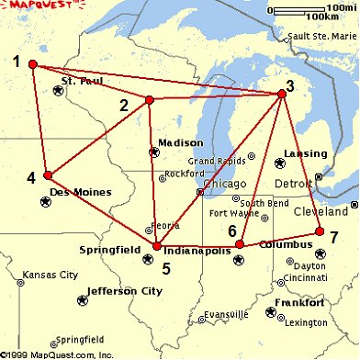
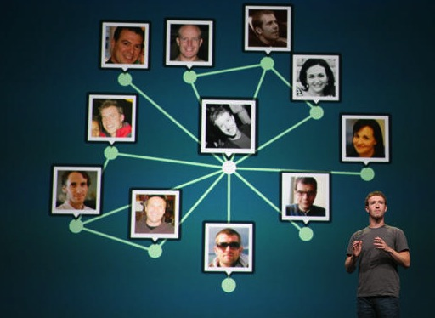
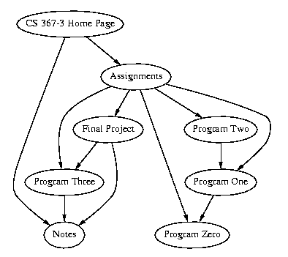
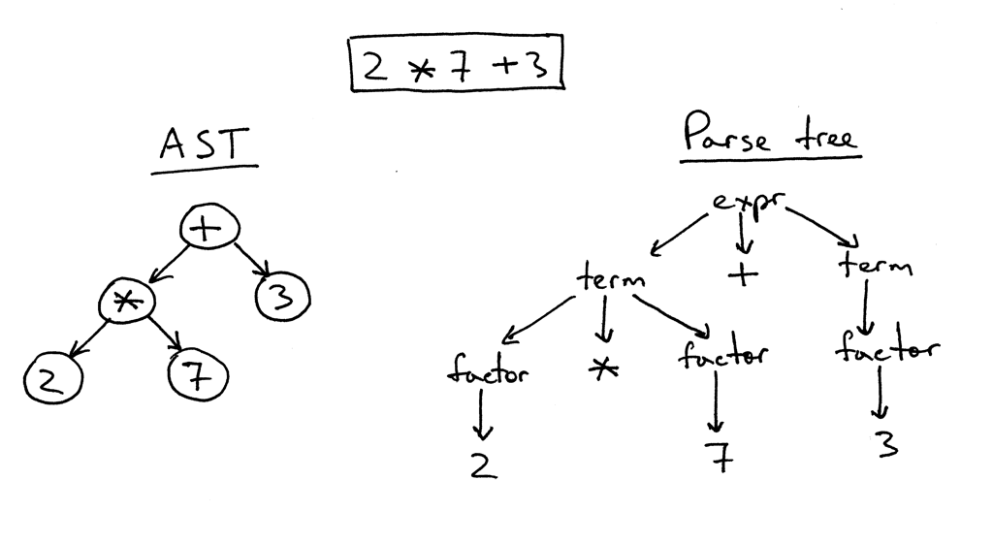
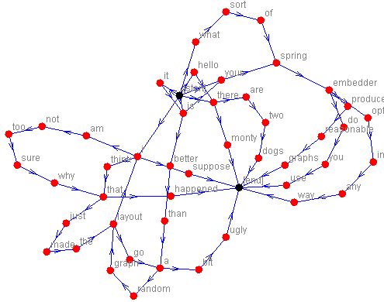
Graphs
Notes:
Graphs can be used to model many types of relations and processes in physical, biological, social and information systems. Many practical problems can be represented by graphs.
In computer science, graphs are used to represent networks of communication, data organization, computational devices, the flow of computation, etc. For instance, the link structure of a website can be represented by a directed graph, in which the vertices represent web pages and directed edges represent links from one page to another. A similar approach can be taken to problems in travel, biology, computer chip design, and many other fields. The development of algorithms to handle graphs is therefore of major interest in computer science.

Slide 7
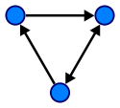
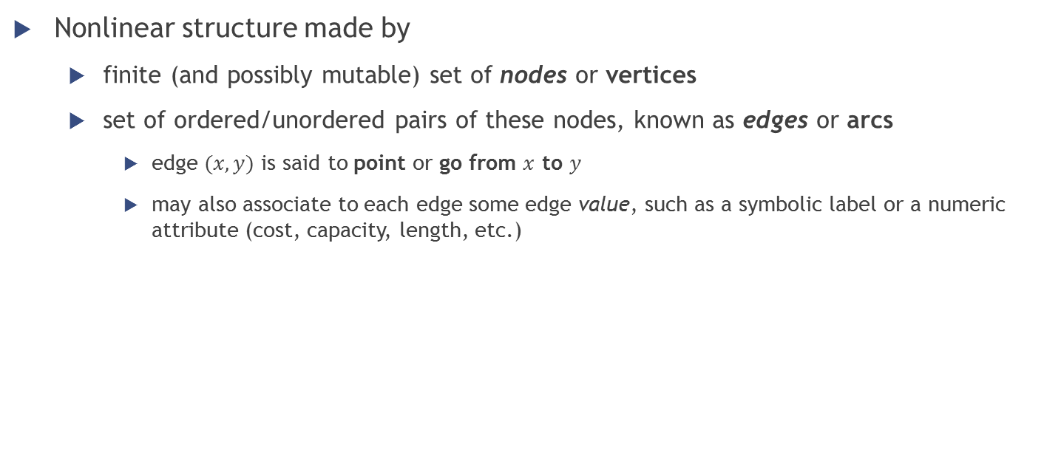
Graphs – Definition
Nonlinear structure made by
finite (and possibly mutable) set of nodes or vertices
set of ordered/unordered pairs of these nodes, known as edges or arcs
edge $(x,y)$ is said to point or go from $x$ to $y$
may also associate to each edge some edge value, such as a symbolic label or a numeric attribute (cost, capacity, length, etc.)

Slide 8
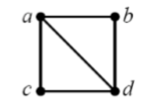
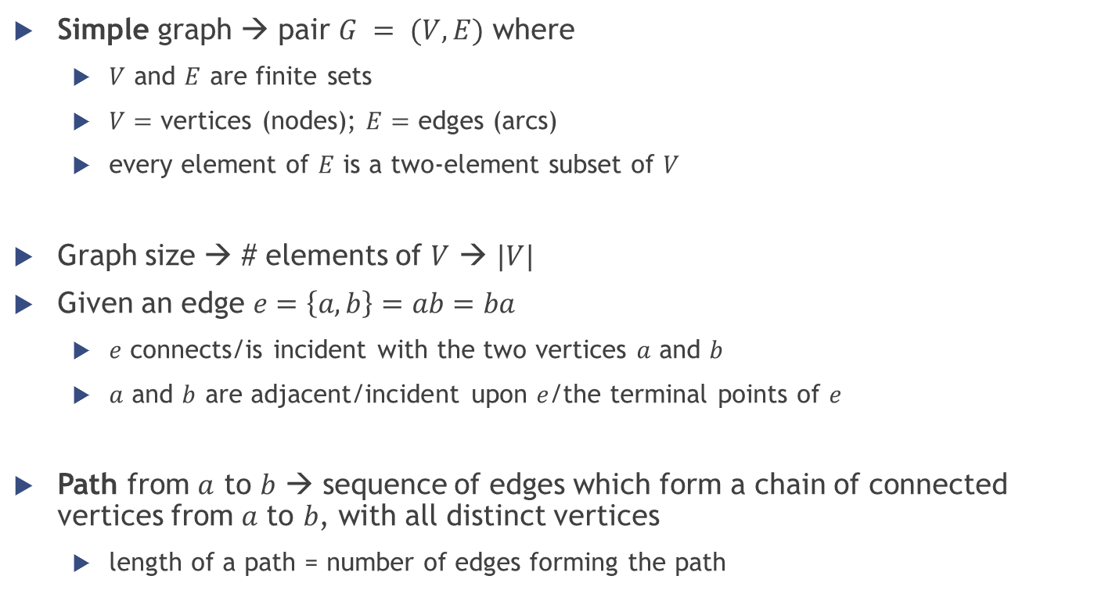


Graphs - Definition
Simple graph → pair $G = (V, E)$ where
$V$ and $E$ are finite sets
$V=$ vertices (nodes); $E=$ edges (arcs)
every element of $E$ is a two-element subset of $V$
Graph size → # elements of $V$ → $|V|$
Given an edge $e=\left\{a,b\right\}=ab=ba$
$e$ connects/is incident with the two vertices $a$ and $b$
$a$ and $b$ are adjacent/incident upon $e$/the terminal points of $e$
Path from $a$ to $b$ → sequence of edges which form a chain of connected vertices from 𝑎 to 𝑏, with all distinct vertices
length of a path = number of edges forming the path
$$V=\left\{a,b,c,d\right\}$$
$$E=\{ab,ac,ad,bd,cd\}$$

Slide 9
Graphs – Representations
Possible data structures for the representation of graphs
Adjacency list
Vertices are stored as records or objects, and every vertex stores a list of adjacent vertices
Adjacency matrix
A two-dimensional matrix, in which the rows represent source vertices and columns represent destination vertices
Incidence matrix
A two-dimensional matrix, in which the rows represent the vertices and columns represent the edges
Not used in practice, we do not study it

Slide 10
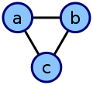
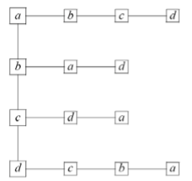
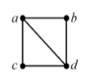
Graphs – Representations
Adjacency list
collection of unordered lists, one for each vertex in the graph
each list describes the set of neighbors of its vertex
a | adjacent to | b,c
b | adjacent to | a,c
c | adjacent to | a,b

Slide 11
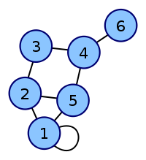
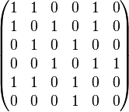

Graphs – Representations
Adjacency matrix
represents which vertices of a graph are adjacent to which other vertices
rows and columns represent both the vertices
given a cell at row $i$ → column $j$ is True(1) if there is an edge connecting $i$ to $j$

Slide 12
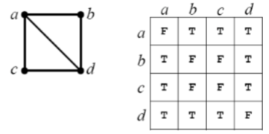
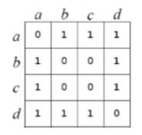
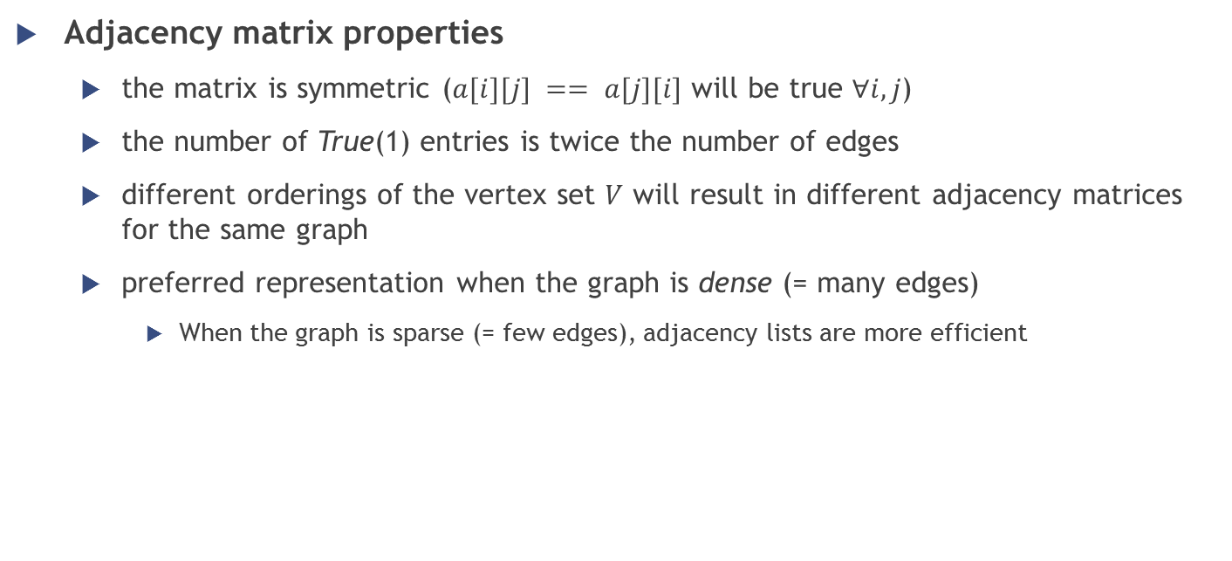
Graphs – Representations
Adjacency matrix properties
the matrix is symmetric ($a[i][j] == a[j][i]$ will be true $∀i,j$)
the number of True(1) entries is twice the number of edges
different orderings of the vertex set $V$ will result in different adjacency matrices for the same graph
preferred representation when the graph is dense (= many edges)
When the graph is sparse (= few edges), adjacency lists are more efficient
Notes:
Adjacency lists are generally preferred because they efficiently represent sparse graphs. An adjacency matrix is preferred if the graph is dense, that is the number of edges |E| is close to the number of vertices squared, |V|², or if one must be able to quickly look up if there is an edge connecting two vertices.

Slide 13
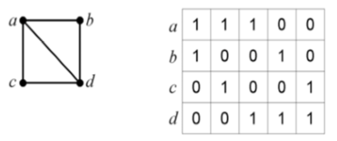
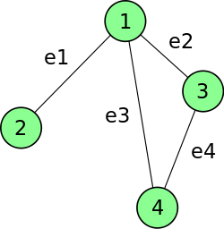


Graphs – Representations
Incidence matrix
shows the relationship between two classes of objects: vertices (rows) and edges (columns)
given a cell at row $i$ → column $j$ is True(1) if vertex $i$ is incident upon edge $j$

Slide 14

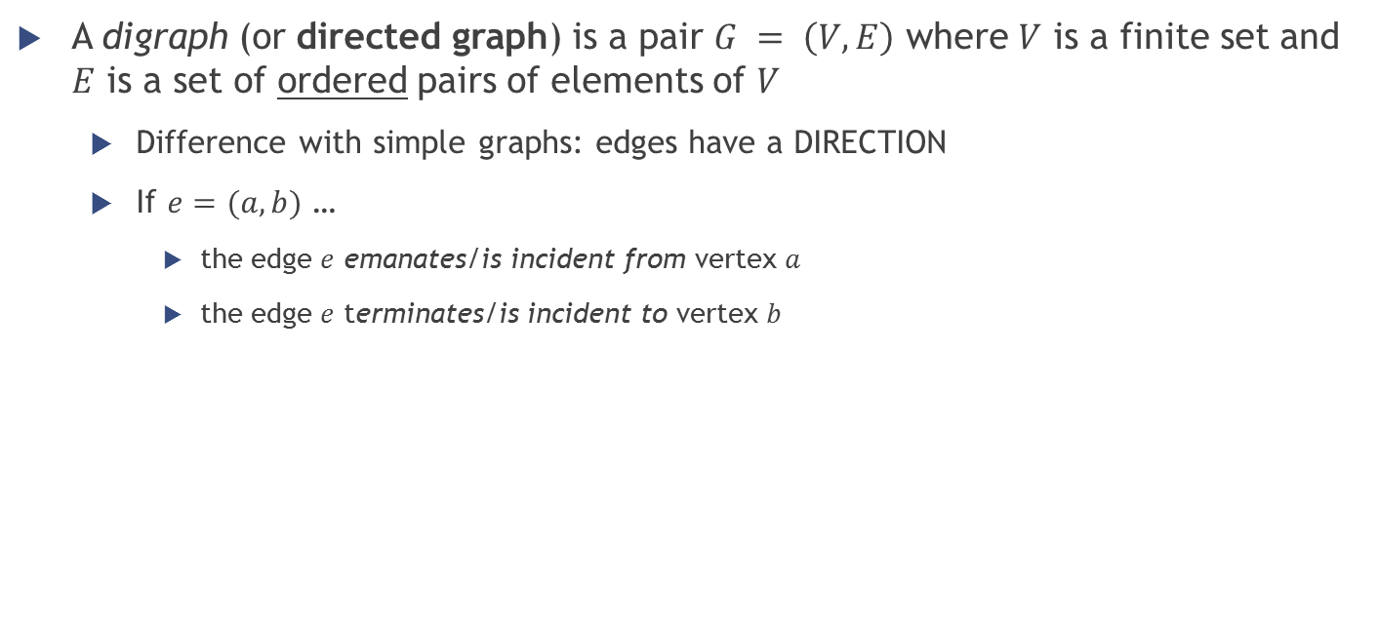
Graphs – Definition of digraph
A digraph (or directed graph) is a pair $G = \left(V, E\right)$ where $V$ is a finite set and $E$ is a set of ordered pairs of elements of $V$
Difference with simple graphs: edges have a DIRECTION
If $e=(a,b)$ …
the edge $e$ emanates/is incident from vertex $a$
the edge $e$ terminates/is incident to vertex $b$

Slide 15
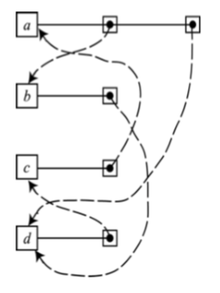
Graphs – Representation of digraphs
Adjacency list of a digraph
for each vertex in the graph, store a list containing the edges that emanate from that vertex
same as the adjacency list for a graph, except that the links are not duplicated unless there are edges going both ways between a pair of vertices

Slide 16
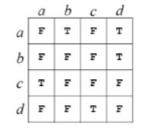

Graphs – Representation of digraphs
Adjacency matrix of a digraph
cell at row $i$, column $j$ is True if there is an edge emanating from vertex $i$ and terminating at vertex $j$

Slide 17
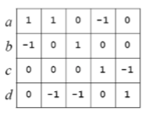
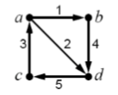

Graphs – Representation of digraphs
Incidence matrix of a digraph
cell at row $i$, column $j$ has value
$1$ if edge $j$ emanates from vertex $i$
$−1$ if edge $j$ terminates at vertex $i$

Slide 18
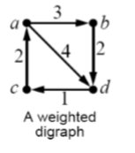
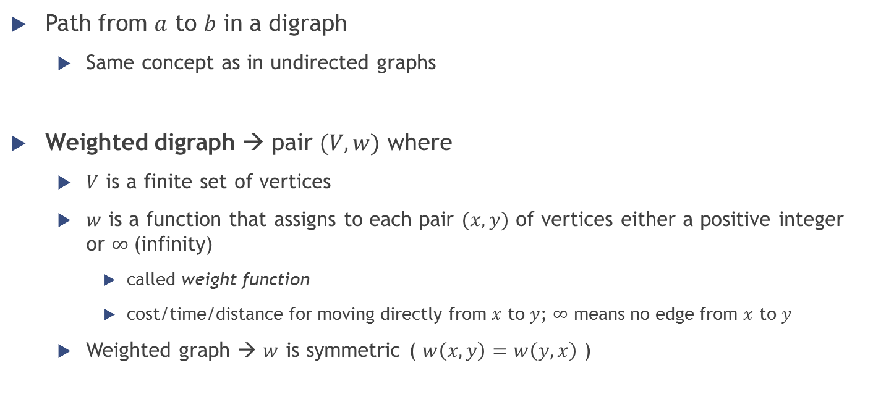
Graphs - Some more terminology
Path from $a$ to $b$ in a digraph
Same concept as in undirected graphs
Weighted digraph → pair $(V,w)$ where
$V$ is a finite set of vertices
$w$ is a function that assigns to each pair $(x, y)$ of vertices either a positive integer or $∞$(infinity)
called weight function
cost/time/distance for moving directly from $x$ to $y$; $∞$ means no edge from $x$ to $y$
Weighted graph → $w$ is symmetric ( $w\left(x,y\right)=w\left(y,x\right)$ )

Slide 19
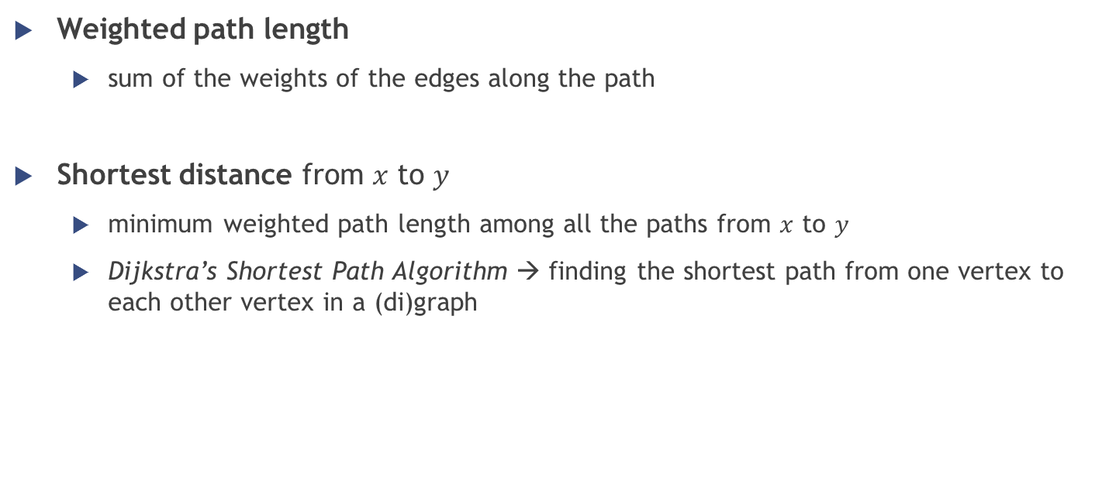
Graphs - Some more terminology
Weighted path length
sum of the weights of the edges along the path
Shortest distance from $x$ to $y$
minimum weighted path length among all the paths from $x$ to $y$
Dijkstra’s Shortest Path Algorithm → finding the shortest path from one vertex to each other vertex in a (di)graph

Slide 20
Graphs – Traversal algorithms
Graph traversal → visiting all the nodes in a graph in a particular manner, updating and/or checking their values along the way
Possible algorithms
BFS (Breadth First Search)
Inspect all neighbors of a node; then for each neighbor inspect all its unvisited neighbors, etc…
DFS (Depth First Search)
Start from one neighbor and go as far as possible in that direction before continuing with exploring the other neighbors

Slide 21
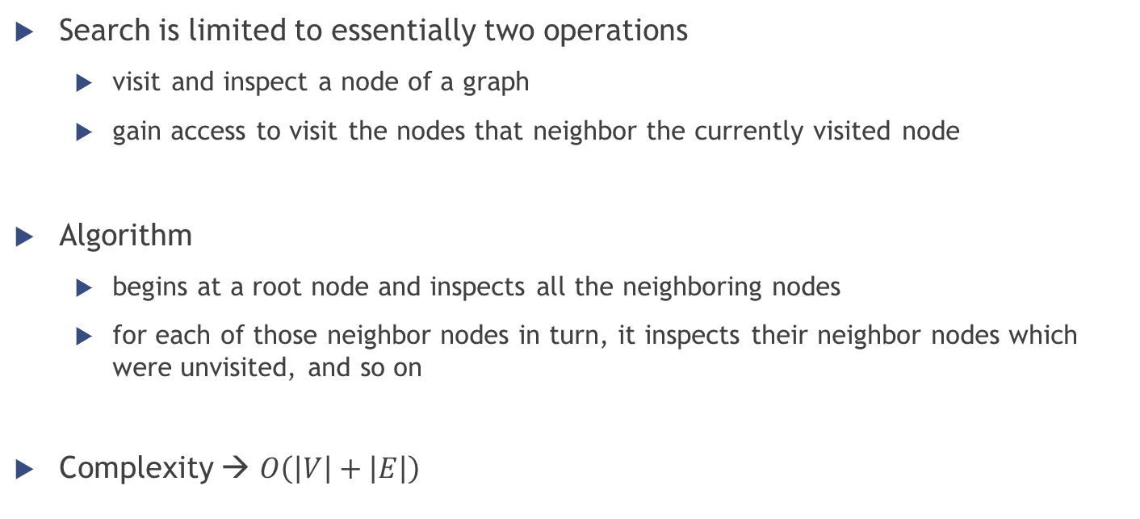
Graph – BFS traversal algorithm
Search is limited to essentially two operations
visit and inspect a node of a graph
gain access to visit the nodes that neighbor the currently visited node
Algorithm
begins at a root node and inspects all the neighboring nodes
for each of those neighbor nodes in turn, it inspects their neighbor nodes which were unvisited, and so on
Complexity → $O\left(\left|V\right|+\left|E\right|\right)$

Slide 22
Graph – BFS traversal algorithm
Queue data structure used to store intermediate results as it traverses the graph
Enqueue the root node
Dequeue a node and examine it
[If the element sought is found in this node, quit the search and return a result]
Otherwise enqueue any successors (the direct child nodes) that have not yet been discovered
If the queue is empty, every node on the graph has been examined [quit the search and return "not found“]
If the queue is not empty, repeat from Step 2

Slide 23
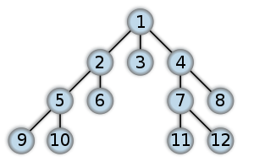
Graph – BFS traversal algorithm
Result of a BFS traversal

Slide 24
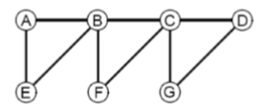
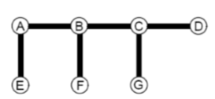
Graph – BFS traversal algorithm
BFS traversal
Returned list of visited vertices: A, B, E, C, F, D, G
Notes:
Queue: A → B, E → E, C, F → F, D, G → D, G → G

Slide 25
Graph – BFS traversal algorithm
Algorithm pseudocode: Breadth-First-Search(Graph, root)
for each node n in Graph:
n.distance = INFINITY
n.parent = NIL
create empty queue Q
root.distance = 0
Q.enqueue(root)
while Q is not empty:
current = Q.dequeue()
for each node n that is adjacent to current:
if n.distance == INFINITY:
n.distance = current.distance + 1
n.parent = current
Q.enqueue(n)
Notes:
Queue: A → B, E → E, C, F → F, D, G → D, G → G

Slide 26
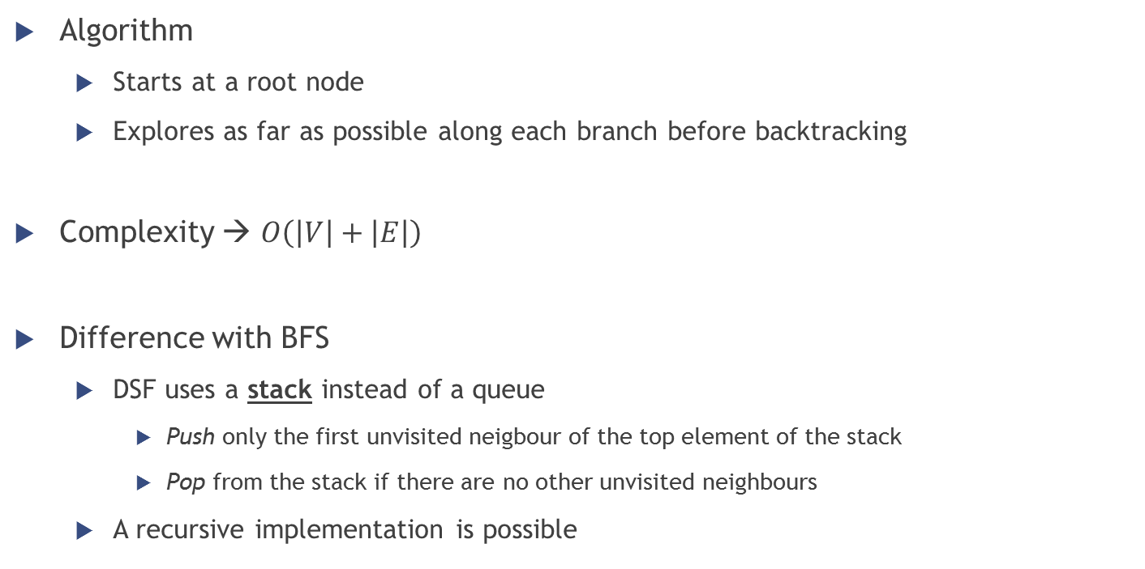
Graph – DFS traversal algorithm
Algorithm
Starts at a root node
Explores as far as possible along each branch before backtracking
Complexity → $O\left(\left|V\right|+\left|E\right|\right)$
Difference with BFS
DSF uses a stack instead of a queue
Push only the first unvisited neigbour of the top element of the stack
Pop from the stack if there are no other unvisited neighbours
A recursive implementation is possible
Notes:
At every iteration push one neighbour of the top node
Pop when no other neighbours to visit exist

Slide 27

Graph – DFS traversal algorithm
BFS was…
Result of a DFS traversal

Slide 28

Graph – DFS traversal algorithm
BFS was…
DFS traversal
Returned list of visited vertices: A, B, C, D, G, F, E
Notes:
Stack: A → A, B → A, B, C → A, B, C, D → A, B, C, D, G → A, B, C, D → A, B, C → A, B, C, F → A, B → A, B, E → A, B → A

Slide 29
Graph – DFS traversal algorithm
Algorithm pseudocode (recursive)
procedure DFS(G,v):
label v as discovered
for all edges from v to w in G.adjacentEdges(v) do
if vertex w is not labeled as discovered then
recursively call DFS(G,w)

Slide 30
Graph – DFS traversal algorithm
Algorithm pseudocode (iterative)
procedure DFS-iterative(G,v):
let S be a stack
S.push(v)
while S is not empty
v = S.pop()
if v is not labeled as discovered:
label v as discovered
for all edges from v to w in G.adjacentEdges(v).reverse() do
S.push(w)

Slide 31
Graphs – Dijkstra’s algorithm
Single-source shortest path problem
for a given source vertex (node) in the graph, the algorithm finds the path with lowest cost (i.e., the shortest path) between that vertex and every other vertex
Informal steps of the algorithm
Pick the unvisited vertex with the lowest-distance
Calculate the distance through it to each unvisited neighbor
Update the neighbor's distance if smaller
Mark as visited when done with neighbors
Notes:
Dijkstra's algorithm will assign some initial distance values and will try to improve them step by step.

Slide 32
Graphs – Dijkstra’s algorithm
Example
Starting node A
B
E
8
1
2
A
4
F
1
6
C
D
3
Pick the unvisited vertex with the lowest-distance
Calculate the distance through it to each unvisited neighbor
Update the neighbor's distance if smaller
Mark as visited when done with neighbors

Slide 33





Graphs – Dijkstra’s algorithm
Example
Starting node A
$$∞$$
$$∞$$
B
E
8
1
0
2
$$∞$$
A
4
F
1
$$∞$$
$$∞$$
6
C
D
3
Pick the unvisited vertex with the lowest-distance
Calculate the distance through it to each unvisited neighbor
Update the neighbor's distance if smaller
Mark as visited when done with neighbors

Slide 34


Graphs – Dijkstra’s algorithm
Example
Starting node A
$$8$$
$$∞$$
B
E
8
1
0
2
$$∞$$
A
4
F
1
$$1$$
$$∞$$
6
C
D
3
Pick the unvisited vertex with the lowest-distance
Calculate the distance through it to each unvisited neighbor
Update the neighbor's distance if smaller
Mark as visited when done with neighbors

Slide 35
Graphs – Dijkstra’s algorithm
Example
Starting node A
$$8$$
$$∞$$
B
E
8
1
0
2
$$∞$$
A
4
F
1
$$1$$
$$∞$$
6
C
D
3
Pick the unvisited vertex with the lowest-distance
Calculate the distance through it to each unvisited neighbor
Update the neighbor's distance if smaller
Mark as visited when done with neighbors

Slide 36
Graphs – Dijkstra’s algorithm
Example
Starting node A
$$8$$
$$∞$$
B
E
8
1
0
2
$$∞$$
A
4
F
1
$$1$$
$$∞$$
6
C
D
3
Pick the unvisited vertex with the lowest-distance
Calculate the distance through it to each unvisited neighbor
Update the neighbor's distance if smaller
Mark as visited when done with neighbors

Slide 37

Graphs – Dijkstra’s algorithm
Example
Starting node A
$$8$$
$$∞$$
B
E
8
1
0
2
$$∞$$
A
4
F
1
$$1$$
$$4$$
6
C
D
3
Pick the unvisited vertex with the lowest-distance
Calculate the distance through it to each unvisited neighbor
Update the neighbor's distance if smaller
Mark as visited when done with neighbors

Slide 38
Graphs – Dijkstra’s algorithm
Example
Starting node A
$$8$$
$$∞$$
B
E
8
1
0
2
$$∞$$
A
4
F
1
$$1$$
$$4$$
6
C
D
3
Pick the unvisited vertex with the lowest-distance
Calculate the distance through it to each unvisited neighbor
Update the neighbor's distance if smaller
Mark as visited when done with neighbors

Slide 39
Graphs – Dijkstra’s algorithm
Example
Starting node A
$$8$$
$$∞$$
B
E
8
1
0
2
$$∞$$
A
4
F
1
$$1$$
$$4$$
6
C
D
3
Pick the unvisited vertex with the lowest-distance
Calculate the distance through it to each unvisited neighbor
Update the neighbor's distance if smaller
Mark as visited when done with neighbors

Slide 40



Graphs – Dijkstra’s algorithm
Example
Starting node A
$$6$$
$$8$$
B
E
8
1
0
2
$$10$$
A
4
F
1
$$1$$
$$4$$
6
C
D
3
Pick the unvisited vertex with the lowest-distance
Calculate the distance through it to each unvisited neighbor
Update the neighbor's distance if smaller
Mark as visited when done with neighbors

Slide 41
Graphs – Dijkstra’s algorithm
Example
Starting node A
$$6$$
$$8$$
B
E
8
1
0
2
$$10$$
A
4
F
1
$$1$$
$$4$$
6
C
D
3
Pick the unvisited vertex with the lowest-distance
Calculate the distance through it to each unvisited neighbor
Update the neighbor's distance if smaller
Mark as visited when done with neighbors

Slide 42
Graphs – Dijkstra’s algorithm
Example
Starting node A
$$6$$
$$8$$
B
E
8
1
0
2
$$10$$
A
4
F
1
$$1$$
$$4$$
6
C
D
3
Pick the unvisited vertex with the lowest-distance
Calculate the distance through it to each unvisited neighbor
Update the neighbor's distance if smaller
Mark as visited when done with neighbors

Slide 43
Graphs – Dijkstra’s algorithm
Example
Starting node A
$$6$$
$$8$$
B
E
8
1
0
2
$$10$$
A
4
F
1
$$1$$
$$4$$
6
C
D
3
Pick the unvisited vertex with the lowest-distance
Calculate the distance through it to each unvisited neighbor
Update the neighbor's distance if smaller
Mark as visited when done with neighbors

Slide 44
Graphs – Dijkstra’s algorithm
Example
Starting node A
$$6$$
$$8$$
B
E
8
1
0
2
$$10$$
A
4
F
1
$$1$$
$$4$$
6
C
D
3
Pick the unvisited vertex with the lowest-distance
Calculate the distance through it to each unvisited neighbor
Update the neighbor's distance if smaller
Mark as visited when done with neighbors

Slide 45

Graphs – Dijkstra’s algorithm
Example
Starting node A
$$6$$
$$8$$
B
E
8
1
0
2
$$9$$
A
4
F
1
$$1$$
$$4$$
6
C
D
3
Pick the unvisited vertex with the lowest-distance
Calculate the distance through it to each unvisited neighbor
Update the neighbor's distance if smaller
Mark as visited when done with neighbors

Slide 46
Graphs – Dijkstra’s algorithm
Example
Starting node A
$$6$$
$$8$$
B
E
8
1
0
2
$$9$$
A
4
F
1
$$1$$
$$4$$
6
C
D
3
Pick the unvisited vertex with the lowest-distance
Calculate the distance through it to each unvisited neighbor
Update the neighbor's distance if smaller
Mark as visited when done with neighbors

Slide 47
Graphs – Dijkstra’s algorithm
Example
Starting node A
$$6$$
$$8$$
B
E
8
1
0
2
$$9$$
A
4
F
1
$$1$$
$$4$$
6
C
D
3
Pick the unvisited vertex with the lowest-distance
Calculate the distance through it to each unvisited neighbor
Update the neighbor's distance if smaller
Mark as visited when done with neighbors

Slide 48
Graphs – Dijkstra’s algorithm
Example
Starting node A
$$6$$
$$8$$
B
E
8
1
0
2
$$9$$
A
4
F
1
$$1$$
$$4$$
6
C
D
3
Pick the unvisited vertex with the lowest-distance
Calculate the distance through it to each unvisited neighbor
Update the neighbor's distance if smaller
Mark as visited when done with neighbors

Slide 49
Graphs – Dijkstra’s algorithm (pseudocode)
function Dijkstra(Graph, source):
create vertex set Q
for each vertex v in Graph: // Initialization
dist[v] ← INFINITY // Unknown distance from source to v
prev[v] ← UNDEFINED // Previous node in optimal path from source
add v to Q // All nodes initially in Q (unvisited nodes)
dist[source] ← 0 // Distance from source to source
while Q is not empty:
u ← vertex in Q with min dist[u] // Source node will be selected first
remove u from Q
for each neighbor v of u: // where v is still in Q.
alt ← dist[u] + length(u, v)
if alt < dist[v]: // A shorter path to v has been found
dist[v] ← alt
prev[v] ← u
return dist[], prev[]

Slide 50
Graphs – Dijkstra’s algorithm
Main steps of the algorithm
Pick the unvisited vertex with the lowest-distance
Calculate the distance through it to each unvisited neighbor
Update the neighbor's distance if smaller
Mark visited when done with neighbors

Slide 51
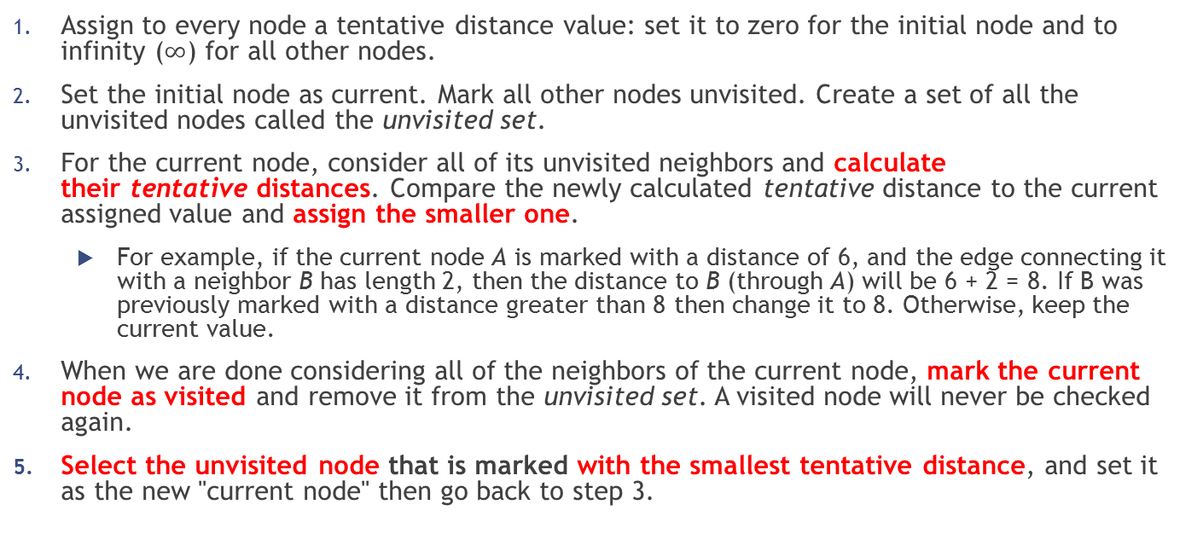
Graphs – Dijkstra’s algorithm
Assign to every node a tentative distance value: set it to zero for the initial node and to infinity ($∞$) for all other nodes.
Set the initial node as current. Mark all other nodes unvisited. Create a set of all the unvisited nodes called the unvisited set.
For the current node, consider all of its unvisited neighbors and calculate their tentative distances. Compare the newly calculated tentative distance to the current assigned value and assign the smaller one.
For example, if the current node A is marked with a distance of 6, and the edge connecting it with a neighbor B has length 2, then the distance to B (through A) will be 6 + 2 = 8. If B was previously marked with a distance greater than 8 then change it to 8. Otherwise, keep the current value.
When we are done considering all of the neighbors of the current node, mark the current node as visited and remove it from the unvisited set. A visited node will never be checked again.
Select the unvisited node that is marked with the smallest tentative distance, and set it as the new "current node" then go back to step 3.

Slide 52

Graphs – Dijkstra’s algorithm
Complexity: $O\left({\left|V\right|}^{2}\right)$
where $\left|V\right|$ is the amount of nodes
Improvable with a Fibonacci heap into: $O\left(\left|E\right|+\left|V\right|\log\left|V\right|\right)$

Slide 53

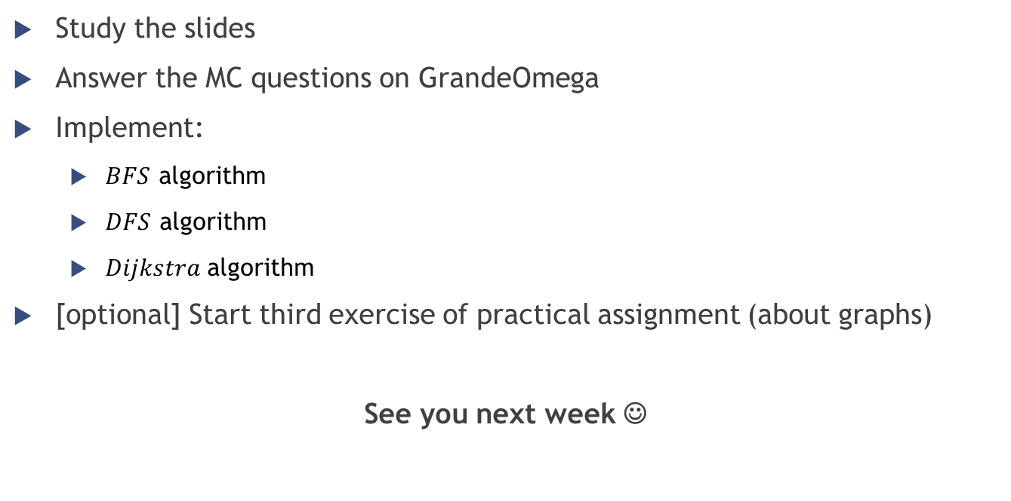
Homework
Study the slides
Answer the MC questions on GrandeOmega
Implement:
$BFS$ algorithm
$DFS$ algorithm
$Dijkstra$algorithm
[optional] Start third exercise of practical assignment (about graphs)
See you next week ☺

Slide 54
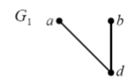
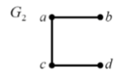

Graphs – Terminology
Subgraph $G′$ of graph $G$
When the vertices and edges of $G′$ are subset of those of $G$
Spanning subgraph
The vertices are the same, but the edges are a subset

Slide 55
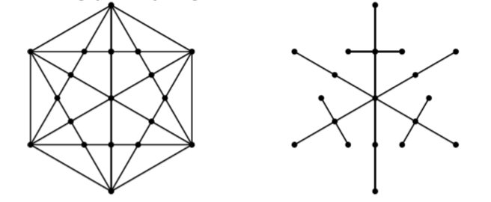
Graphs – Terminology
Connected graph
Every pair of its vertices is connected by some path
Acyclic graph
It contains no cycles
Spanning tree of a graph
connected acyclic spanning subgraph

Slide 56
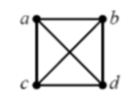
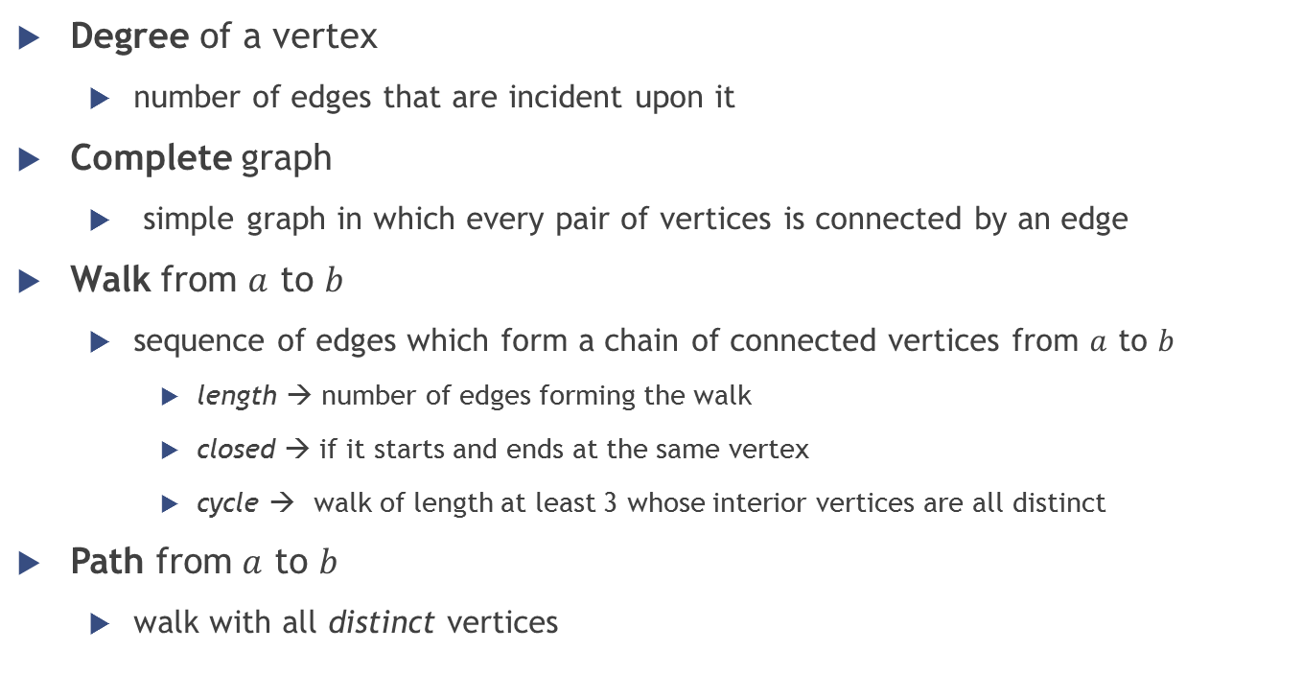
Graphs – Terminology
Degree of a vertex
number of edges that are incident upon it
Complete graph
simple graph in which every pair of vertices is connected by an edge
Walk from $a$ to $b$
sequence of edges which form a chain of connected vertices from $a$ to $b$
length → number of edges forming the walk
closed → if it starts and ends at the same vertex
cycle → walk of length at least 3 whose interior vertices are all distinct
Path from $a$ to $b$
walk with all distinct vertices
Notes:
sum of the degrees of the vertices of a graph with $m$ edges is $2m$
number of edges in the complete graph on $n$ vertices is $\frac{n\left(n–1\right)}{2}$

Slide 57

Terminology digraph
Outdegree of a vertex = number of edges emanating from it
Indegree of a vertex = number of edges terminating in it
Loop → $e=(a,a)$

